Slide 1
Math. for CS
Ch 3- Logical Formulas
Prof. Shunxiang Zhang
Anhui University of Science & Technology
Computer Science and Engineering
Mobile Phone：189-6377-7827
Email：sxzh666@gmail.com;sxzhang@aust.edu.cn

Slide 2
Topics covered/Contents
3.1 Propositions from Propositions
3.2 Propositional Logic in Computer Programs
3.3 Equivalence and Validity
3.4 The Algebra of Propositions
3.5 The SAT Problem
3.6 Predicate Formulas

Slide 3
Ch 3- Logical Formulas
It is amazing that people manage to cope with all the ambiguities in the English language. Here are some sentences that illustrate the issue:
“You may have cake, or you may have ice cream.”
“If pigs can fly, then your account won’t get hacked.”
“If you can solve any problem we come up with, then you get an A for the course.”
“Every Chinese has a dream.”
What precisely do these sentences mean? Can you have both cake and ice cream or must you choose just one dessert? Pigs can’t fly, so does the second sentence say
anything about the security of your account? If you can solve some problems we
come up with, can you get an A for the course? And if you can’t solve a single one
of the problems, does it mean you can’t get an A? Finally, does the last sentence
imply that all Chinese have the same dream—say of owning a house, a car—or might different Chinese have different?

Slide 4
Ch 3- Logical Formulas
Some uncertainty is tolerable in normal conversation. But when we need to
formulate ideas precisely—as in mathematics and programming—the mbiguities
inherent in everyday language can be a real problem. We can’t hope to make an
exact argument if we’re not sure exactly what the statements mean. So before we
start into mathematics, we need to investigate the problem of how to talk about
mathematics.
To get around (solve; deal with; cope with; handle) the ambiguity of English, mathematicians have devised a special language for talking about logical relationships. This language mostly uses ordinary English words and phrases such as “or,” “implies,” and “for all.” But mathematicians give these words precise and unambiguous definitions which don’t always match common usage.
Surprisingly, in the midst of learning the language of logic, we’ll come across
the most important open problem in computer science—a problem whose solution
could change the world.

Slide 5
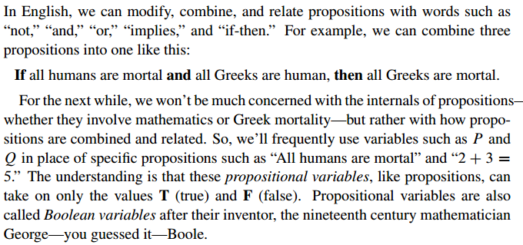
3.1 Propositions from Propositions

Slide 6
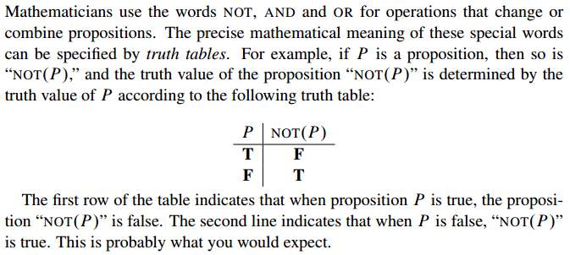
3.1 Propositions from Propositions

Slide 7
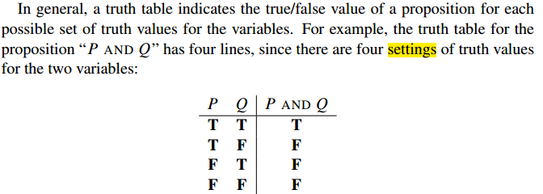
3.1 Propositions from Propositions

Slide 8
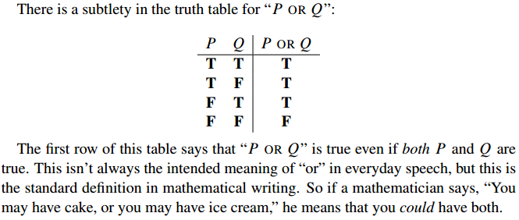
3.1 Propositions from Propositions

Slide 9
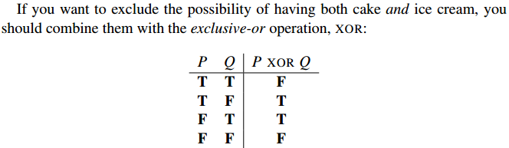
3.1 Propositions from Propositions

Slide 10
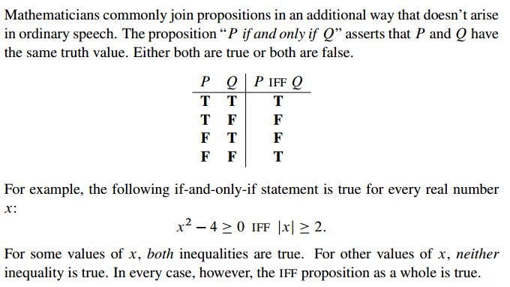
3.1 Propositions from Propositions

Slide 11
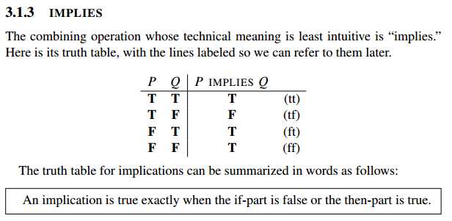
3.1 Propositions from Propositions

Slide 12
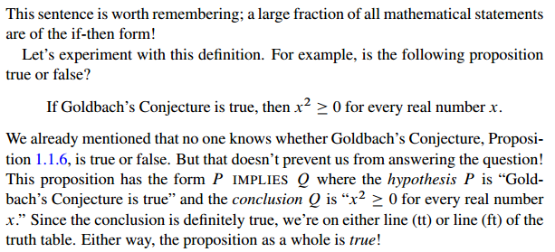
3.1 Propositions from Propositions

Slide 13
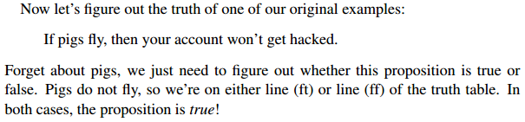
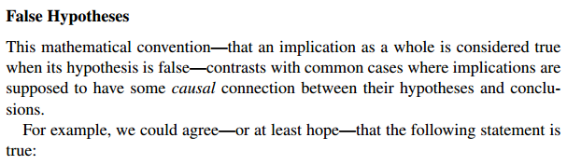
3.1 Propositions from Propositions

Slide 14
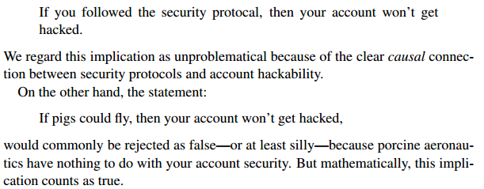
3.1 Propositions from Propositions

Slide 15
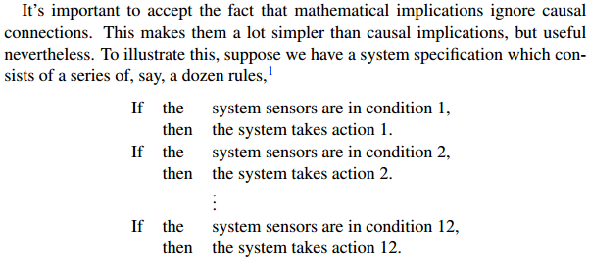
3.1 Propositions from Propositions

Slide 16
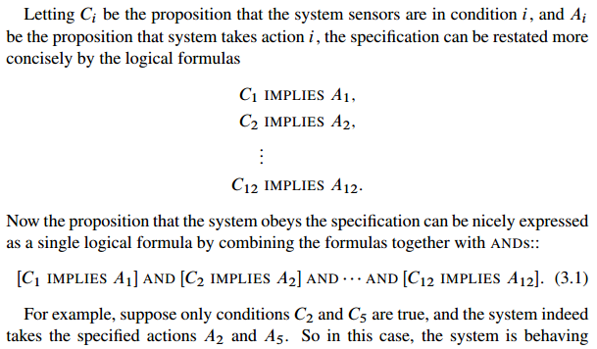
3.1 Propositions from Propositions

Slide 17
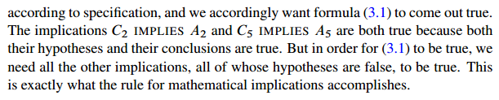
3.1 Propositions from Propositions

Slide 18
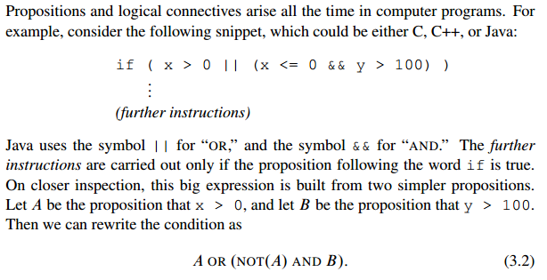
3.2 Propositional Logic in Computer Programs

Slide 19
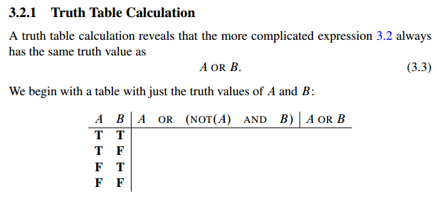
3.2 Propositional Logic in Computer Programs

Slide 20
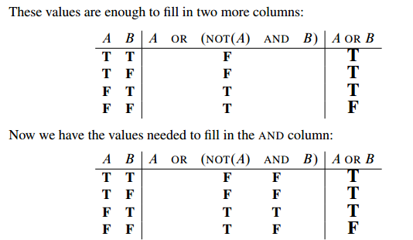
3.2 Propositional Logic in Computer Programs

Slide 21
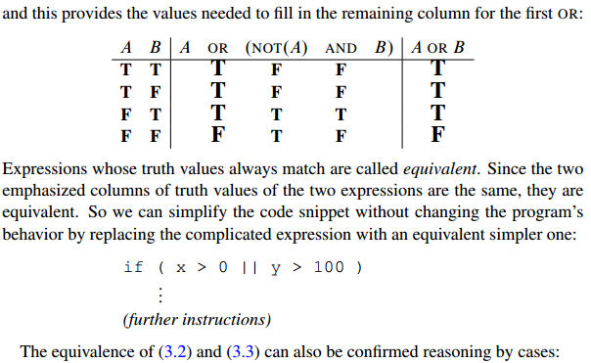
3.2 Propositional Logic in Computer Programs

Slide 22
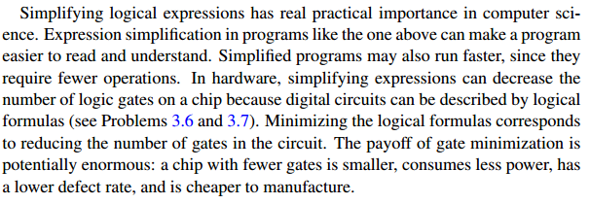
3.2 Propositional Logic in Computer Programs

Slide 23

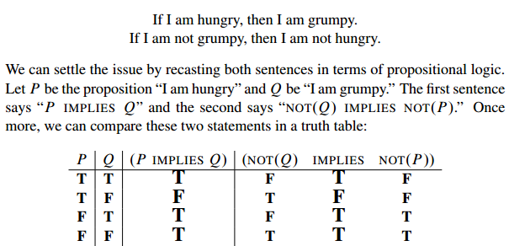
3.3 Equivalence and Validity

Slide 24
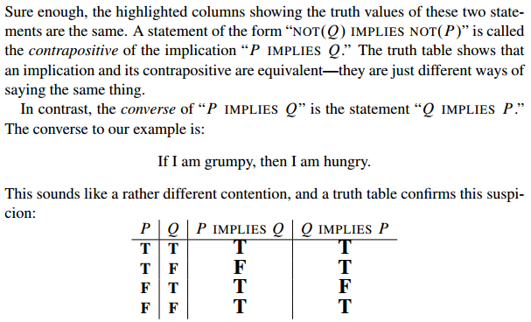
3.3 Equivalence and Validity

Slide 25
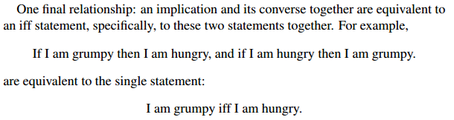
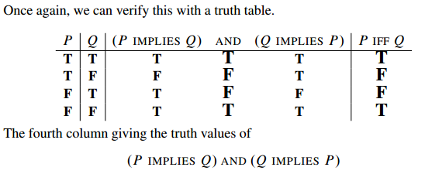
3.3 Equivalence and Validity

Slide 26
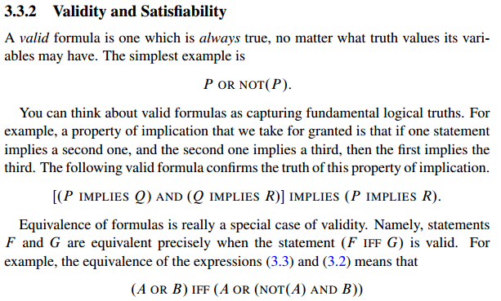
3.3 Equivalence and Validity

Slide 27
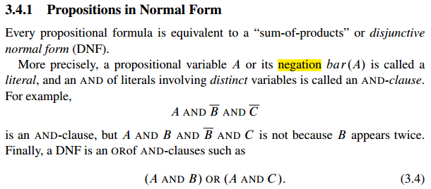
3.4 The Algebra of Propositions

Slide 28
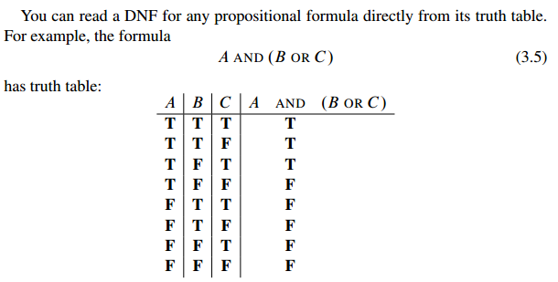
3.4 The Algebra of Propositions

Slide 29
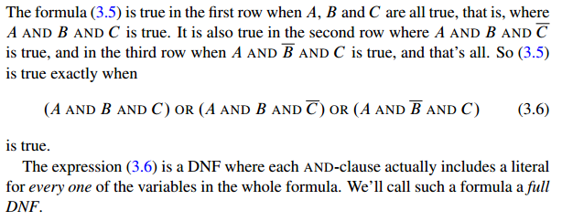
3.4 The Algebra of Propositions

Slide 30
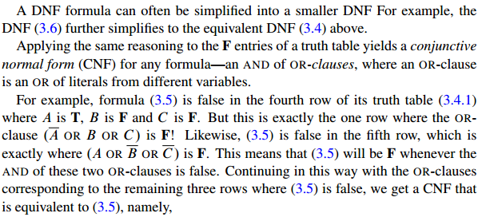
3.4 The Algebra of Propositions

Slide 31
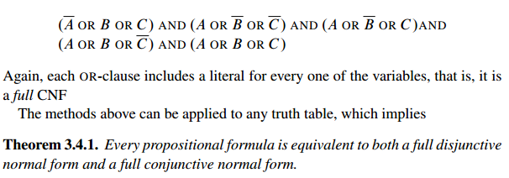
3.4 The Algebra of Propositions

Slide 32
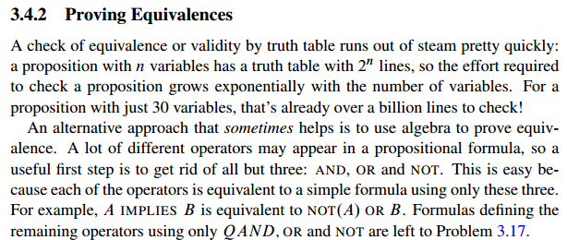
3.4 The Algebra of Propositions

Slide 33

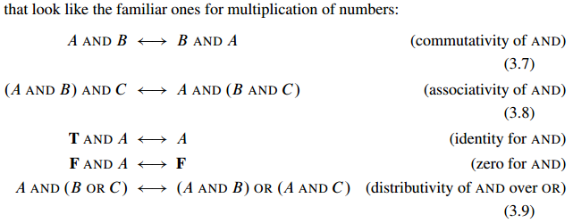
3.4 The Algebra of Propositions

Slide 34
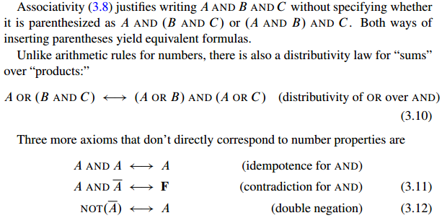
3.4 The Algebra of Propositions

Slide 35
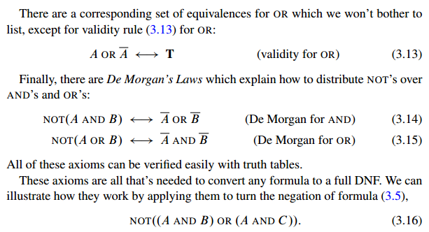
3.4 The Algebra of Propositions

Slide 36
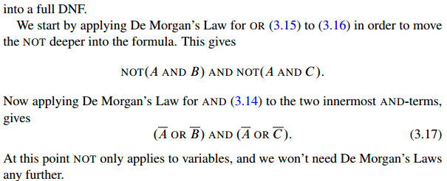
3.4 The Algebra of Propositions

Slide 37
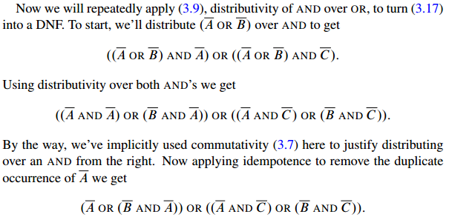
3.4 The Algebra of Propositions

Slide 38
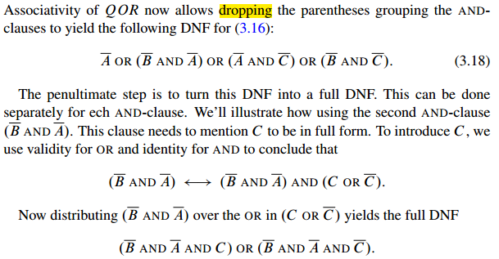
3.4 The Algebra of Propositions

Slide 39
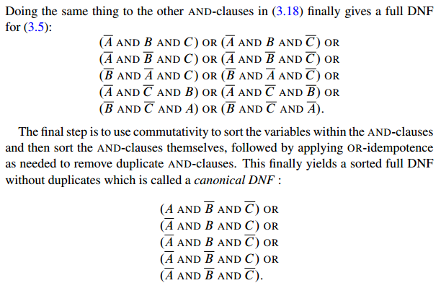
3.4 The Algebra of Propositions

Slide 40
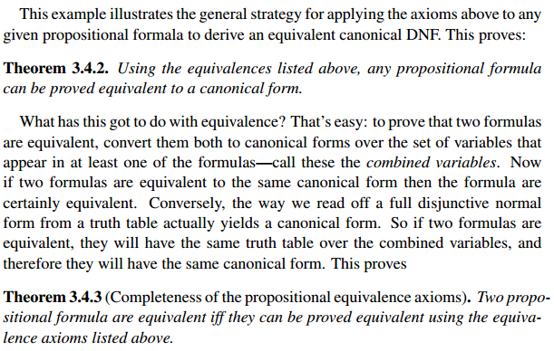
3.4 The Algebra of Propositions

Slide 41
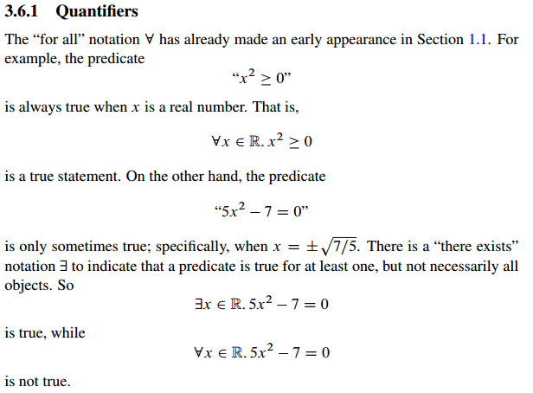
3.6 Predicate Formulas

Slide 42
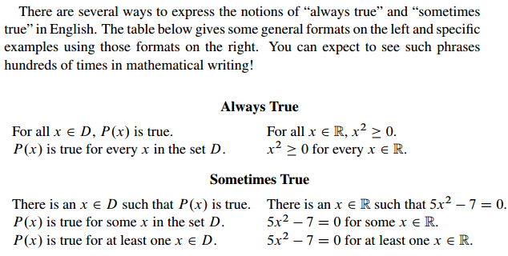
3.6 Predicate Formulas

Slide 43
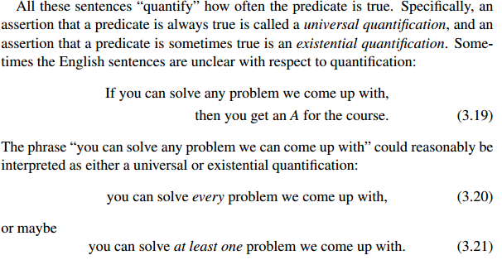
3.6 Predicate Formulas

Slide 44
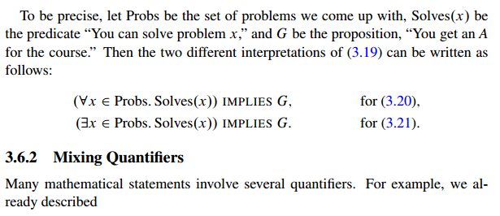
3.6 Predicate Formulas

Slide 45
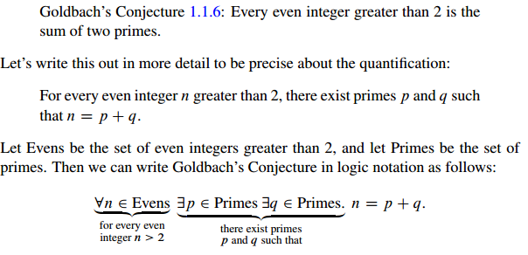
3.6 Predicate Formulas

Slide 46
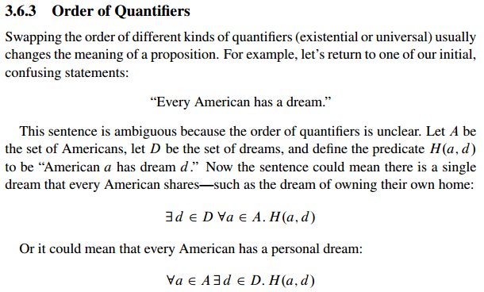
3.6 Predicate Formulas

Slide 47
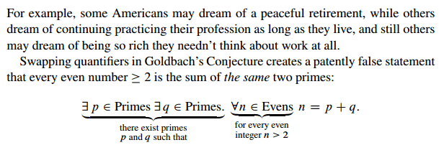
3.6 Predicate Formulas

Slide 48
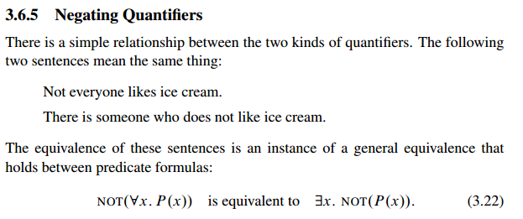
3.6 Predicate Formulas

Slide 49
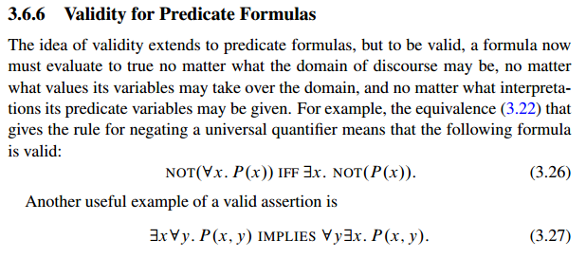
3.6 Predicate Formulas

Slide 50
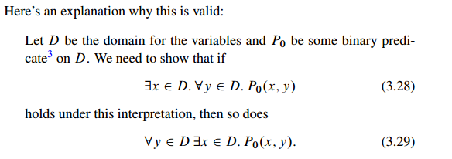
3.6 Predicate Formulas

Slide 51

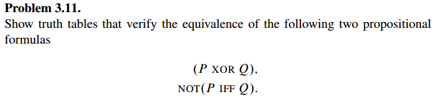
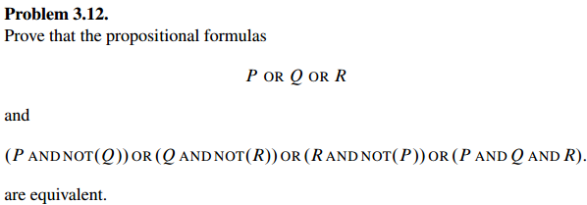
3.7 Group/Panel discussion
Group 1

Slide 52


3.7 Group/Panel discussion
Group 1

Slide 53

3.7 Group/Panel discussion
Group 1

